Slide 1
Semi-Auto Labelling

Slide 2
Dividing up images
Images are divided into 4 quartiles by their average intensity
Done by a script

Slide 3
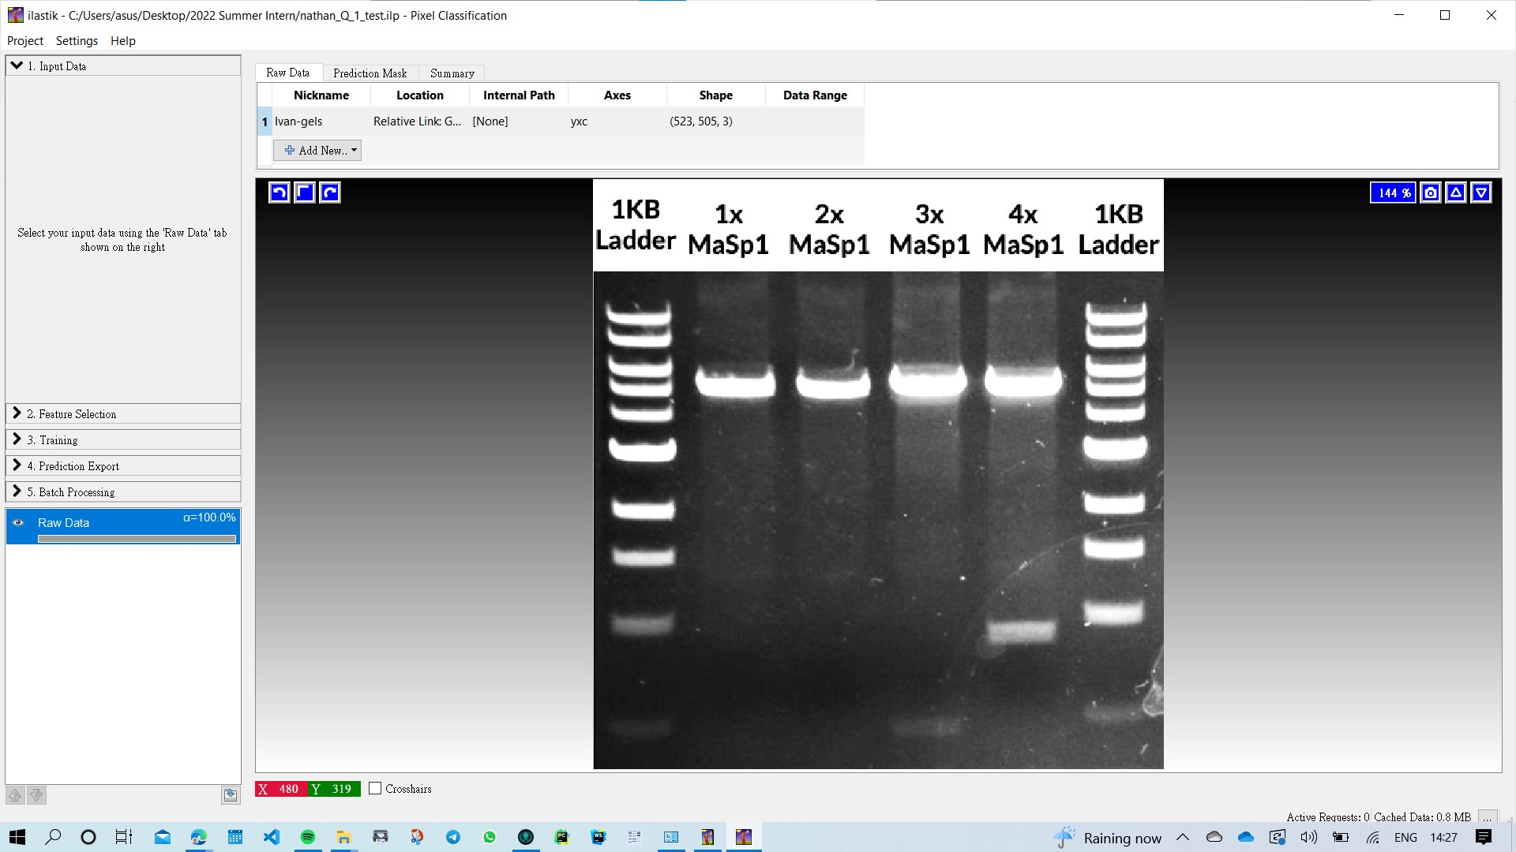
Ilastik: Select 1 image for training classifier

Slide 4
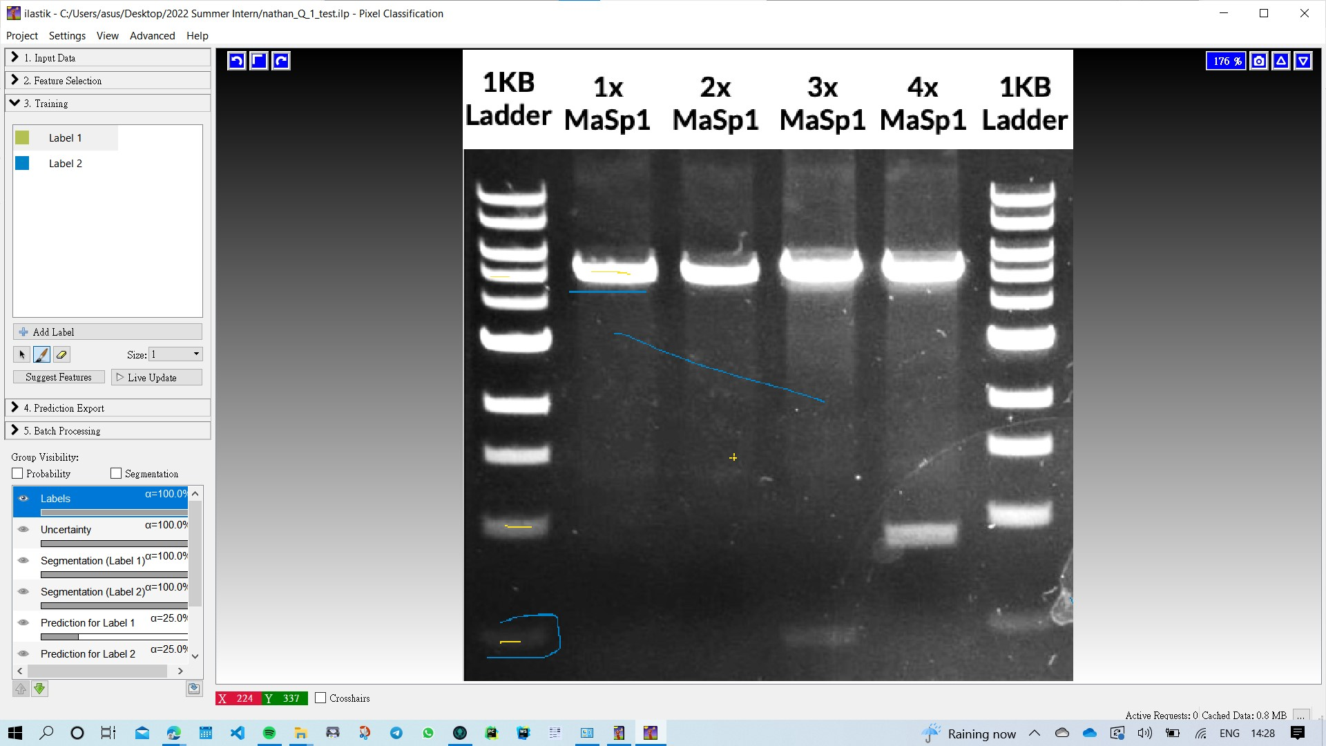
Annotating labels of 2 types (foreground/background)

Slide 5
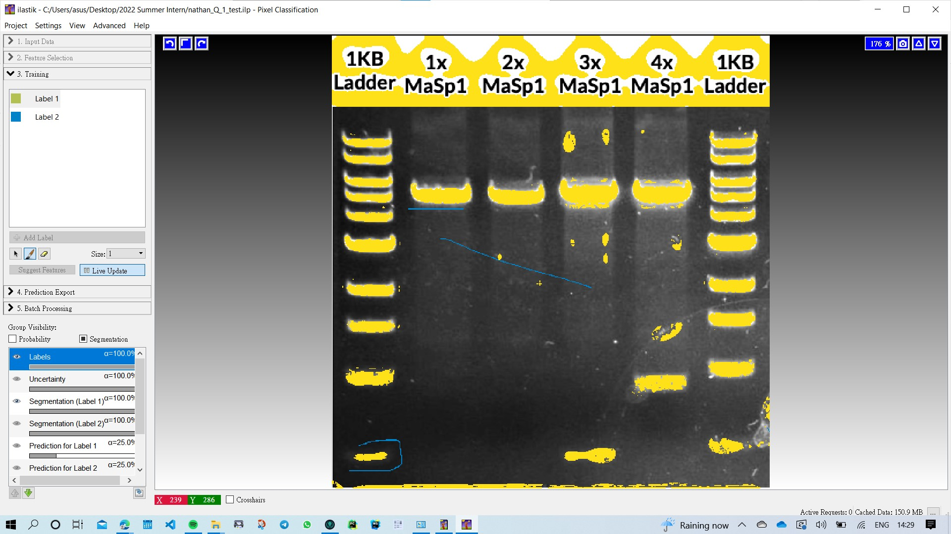
Press ‘Live Update’, which would automatically label the rest of the image The yellow parts are foreground More labels can be added/removed to modify and train the classifier

Slide 6
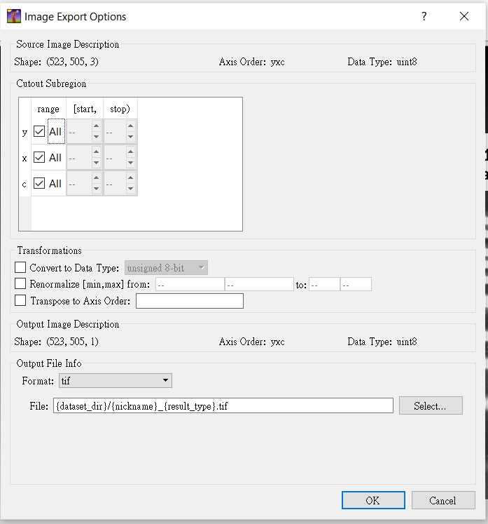
Select Images to load classifier on, and output the segmentation map as tif files

Slide 7
Results
Show PDF: https://github.com/mattaq31/Automatic-Gel-Analysis/blob/0c425f91f25563364898a50247bd43397b573a55/Semi-Auto%20Labelling/Ilastik/nathan_Q1.pdf

Slide 8
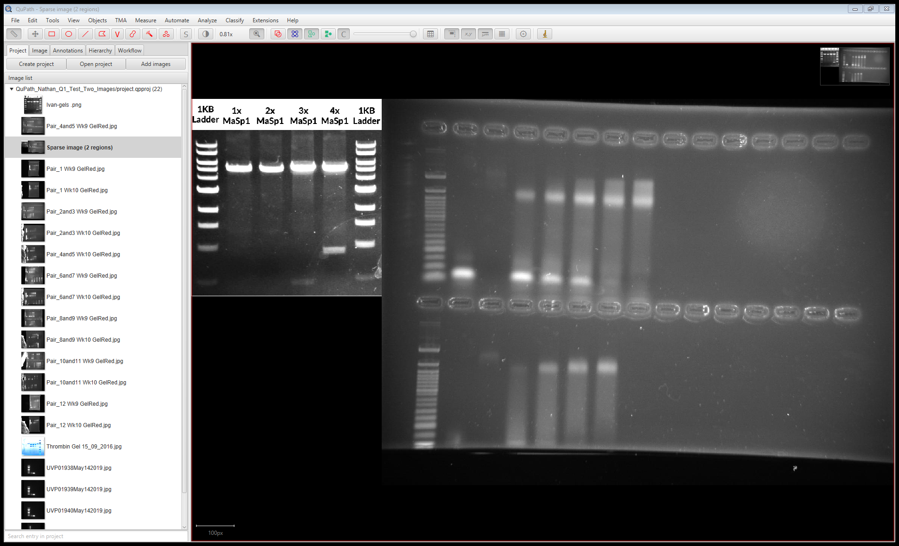
QuPath: 2 Images are needed to train a classifier, results for using 1 image is too inaccurate Images are combined into 1 for annotating in QuPath

Slide 9
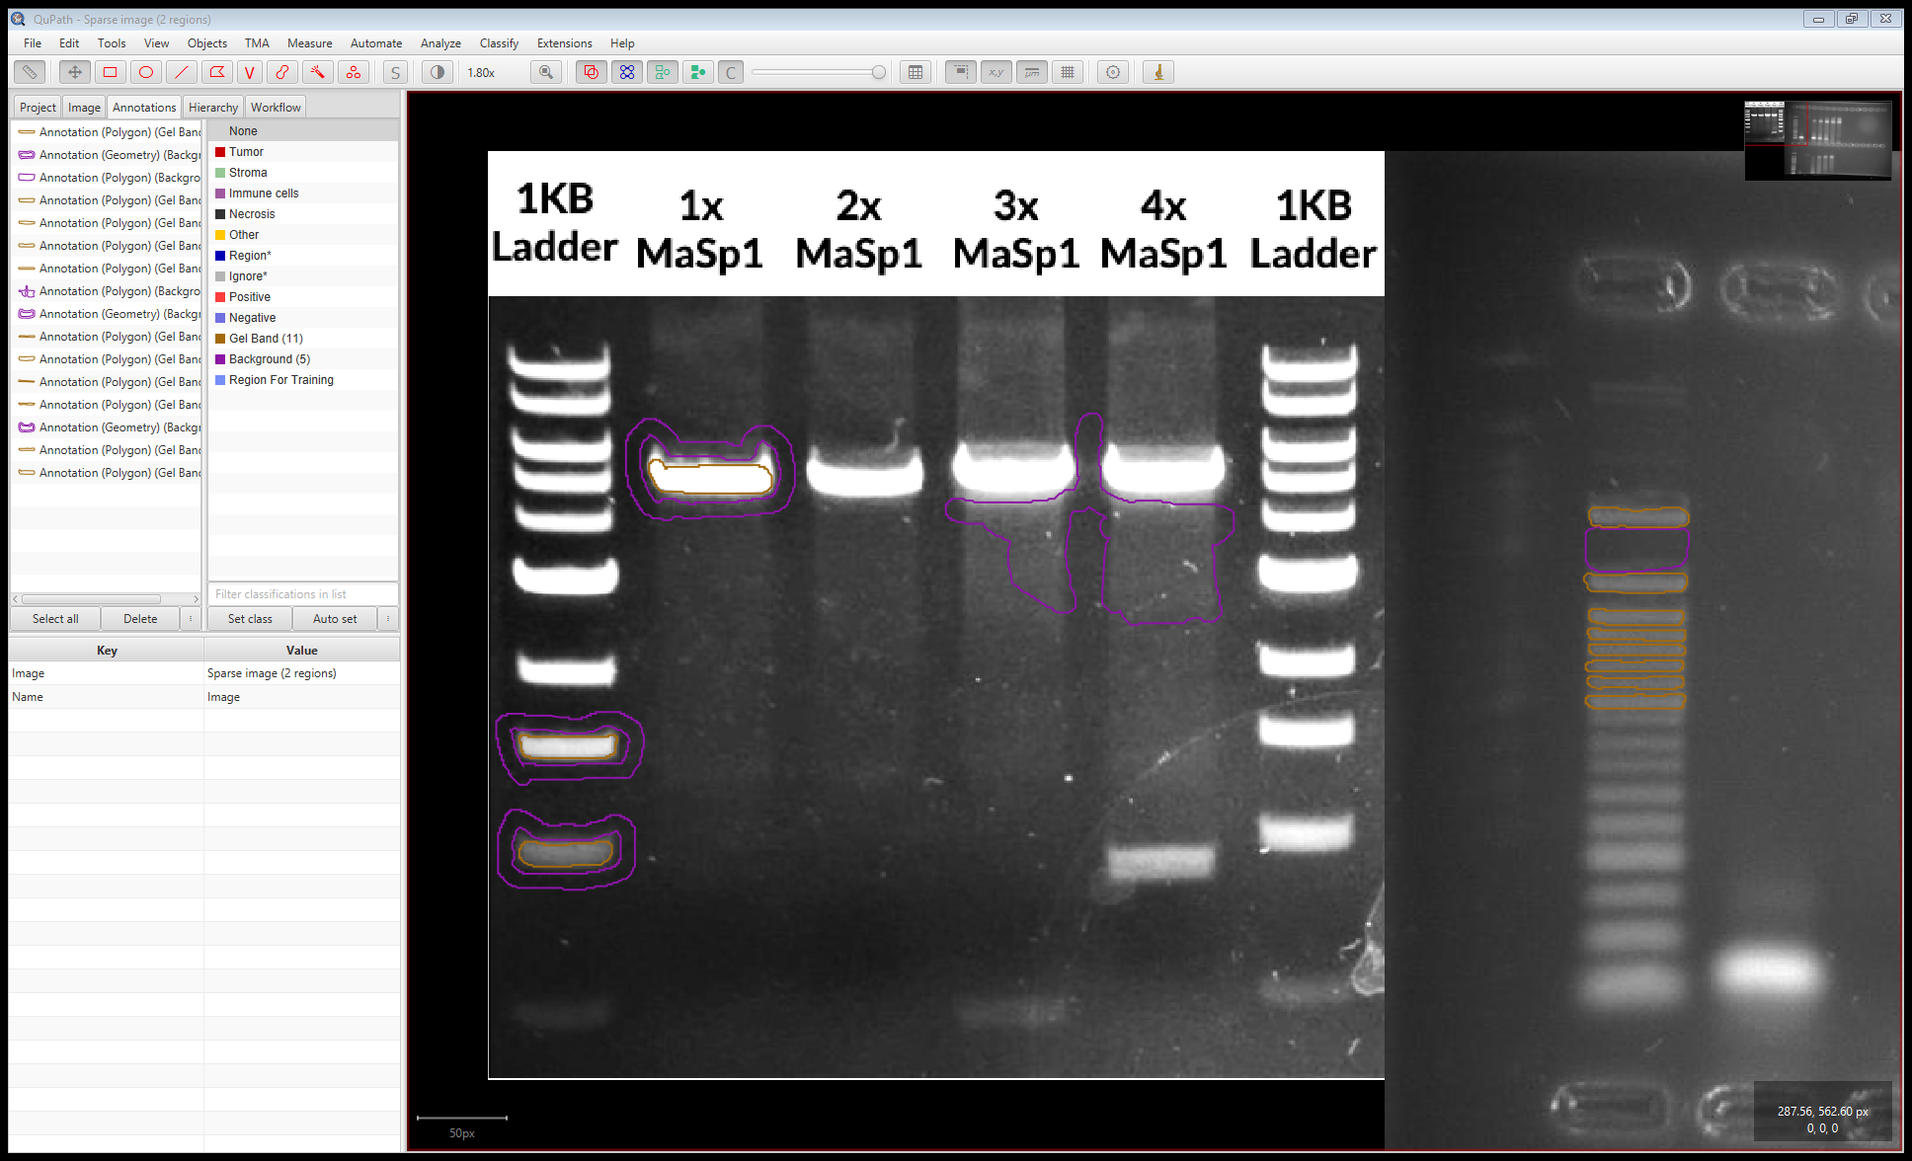
Annotate regions into foreground/background Quite a lot of annotations are needed

Slide 10
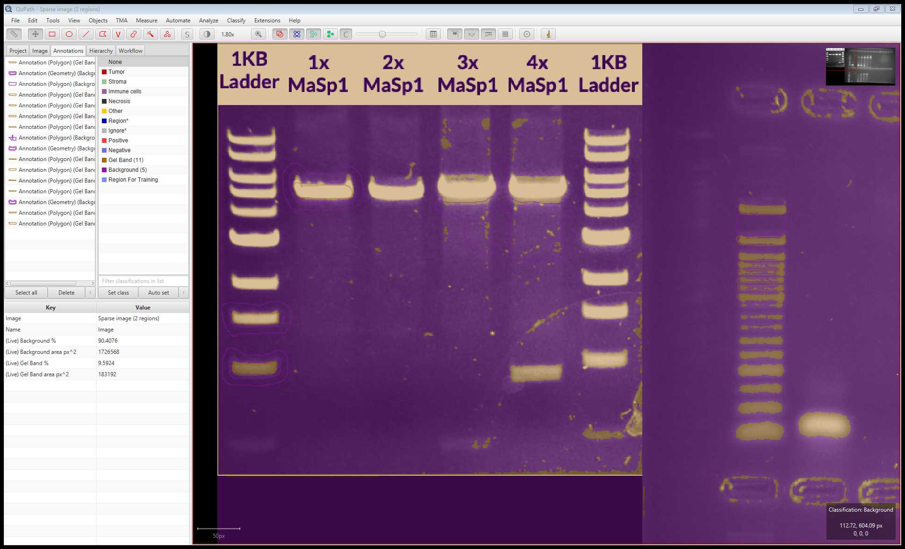
Highest resolution/ Most scales chosen, this is the prediction of classifier trained

Slide 11
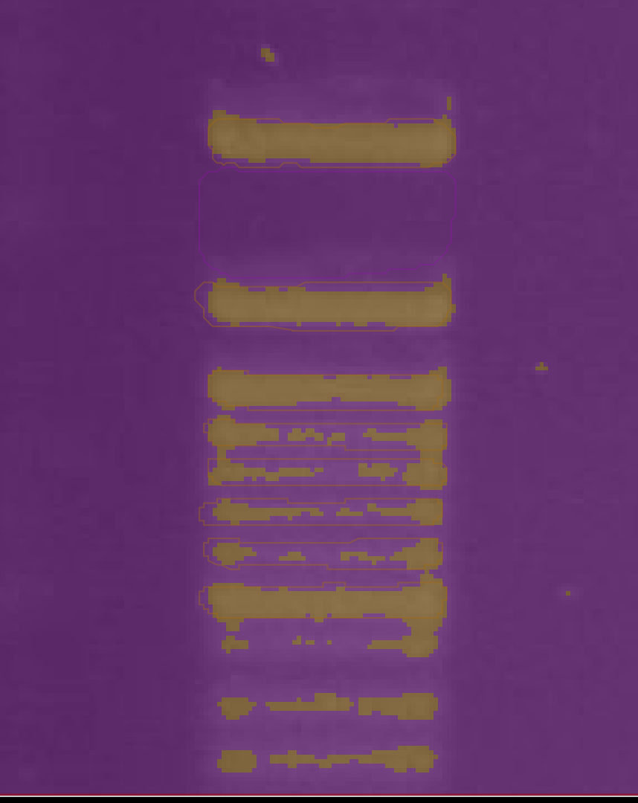
This is the ladder, some (parts of) gel bands are explicitly annotated to be foreground, but the classifier stills classifies it as background

Slide 12
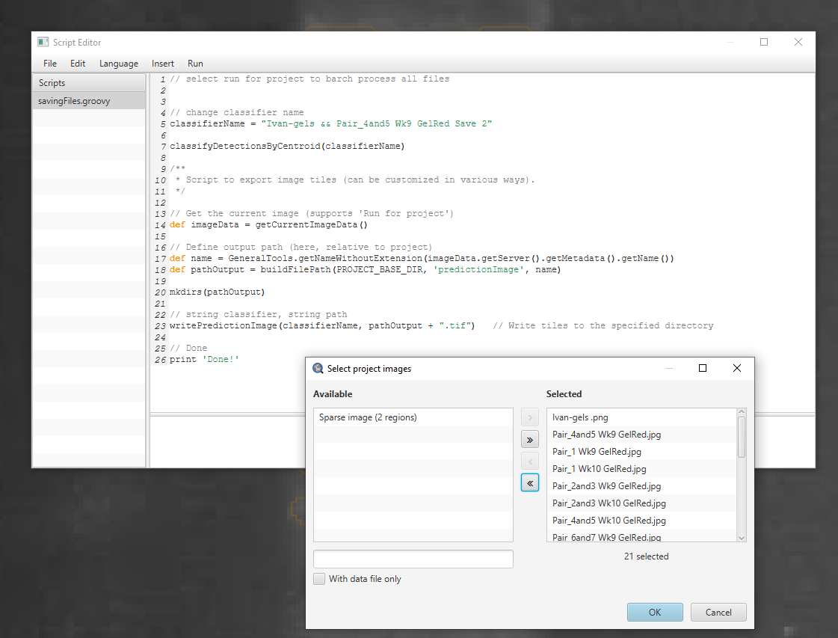
With QuPath scripts and automation function, the trained classifier is applied on all selected images

Slide 13
Results and Comparison with Ilastik
PDF Link: https://github.com/mattaq31/Automatic-Gel-Analysis/blob/0c425f91f25563364898a50247bd43397b573a55/Semi-Auto%20Labelling/nathan_Q1_Comparison.pdf

Slide 14
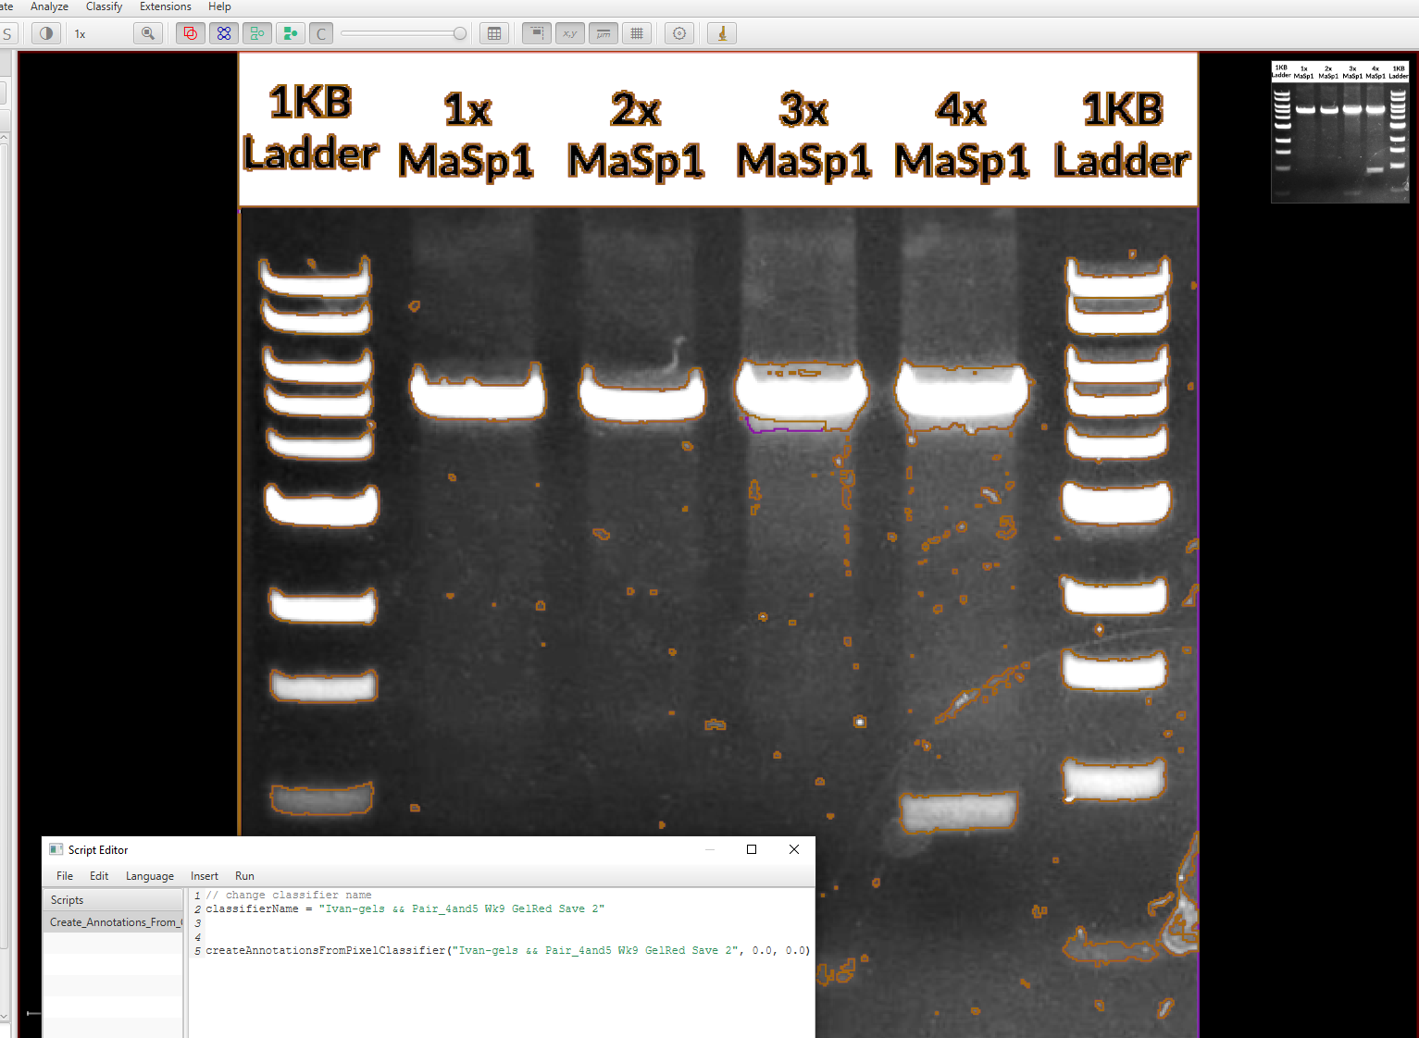
Further editing of segmentation maps on QuPath: With help of script, annotations of segmented regions are created

Slide 15
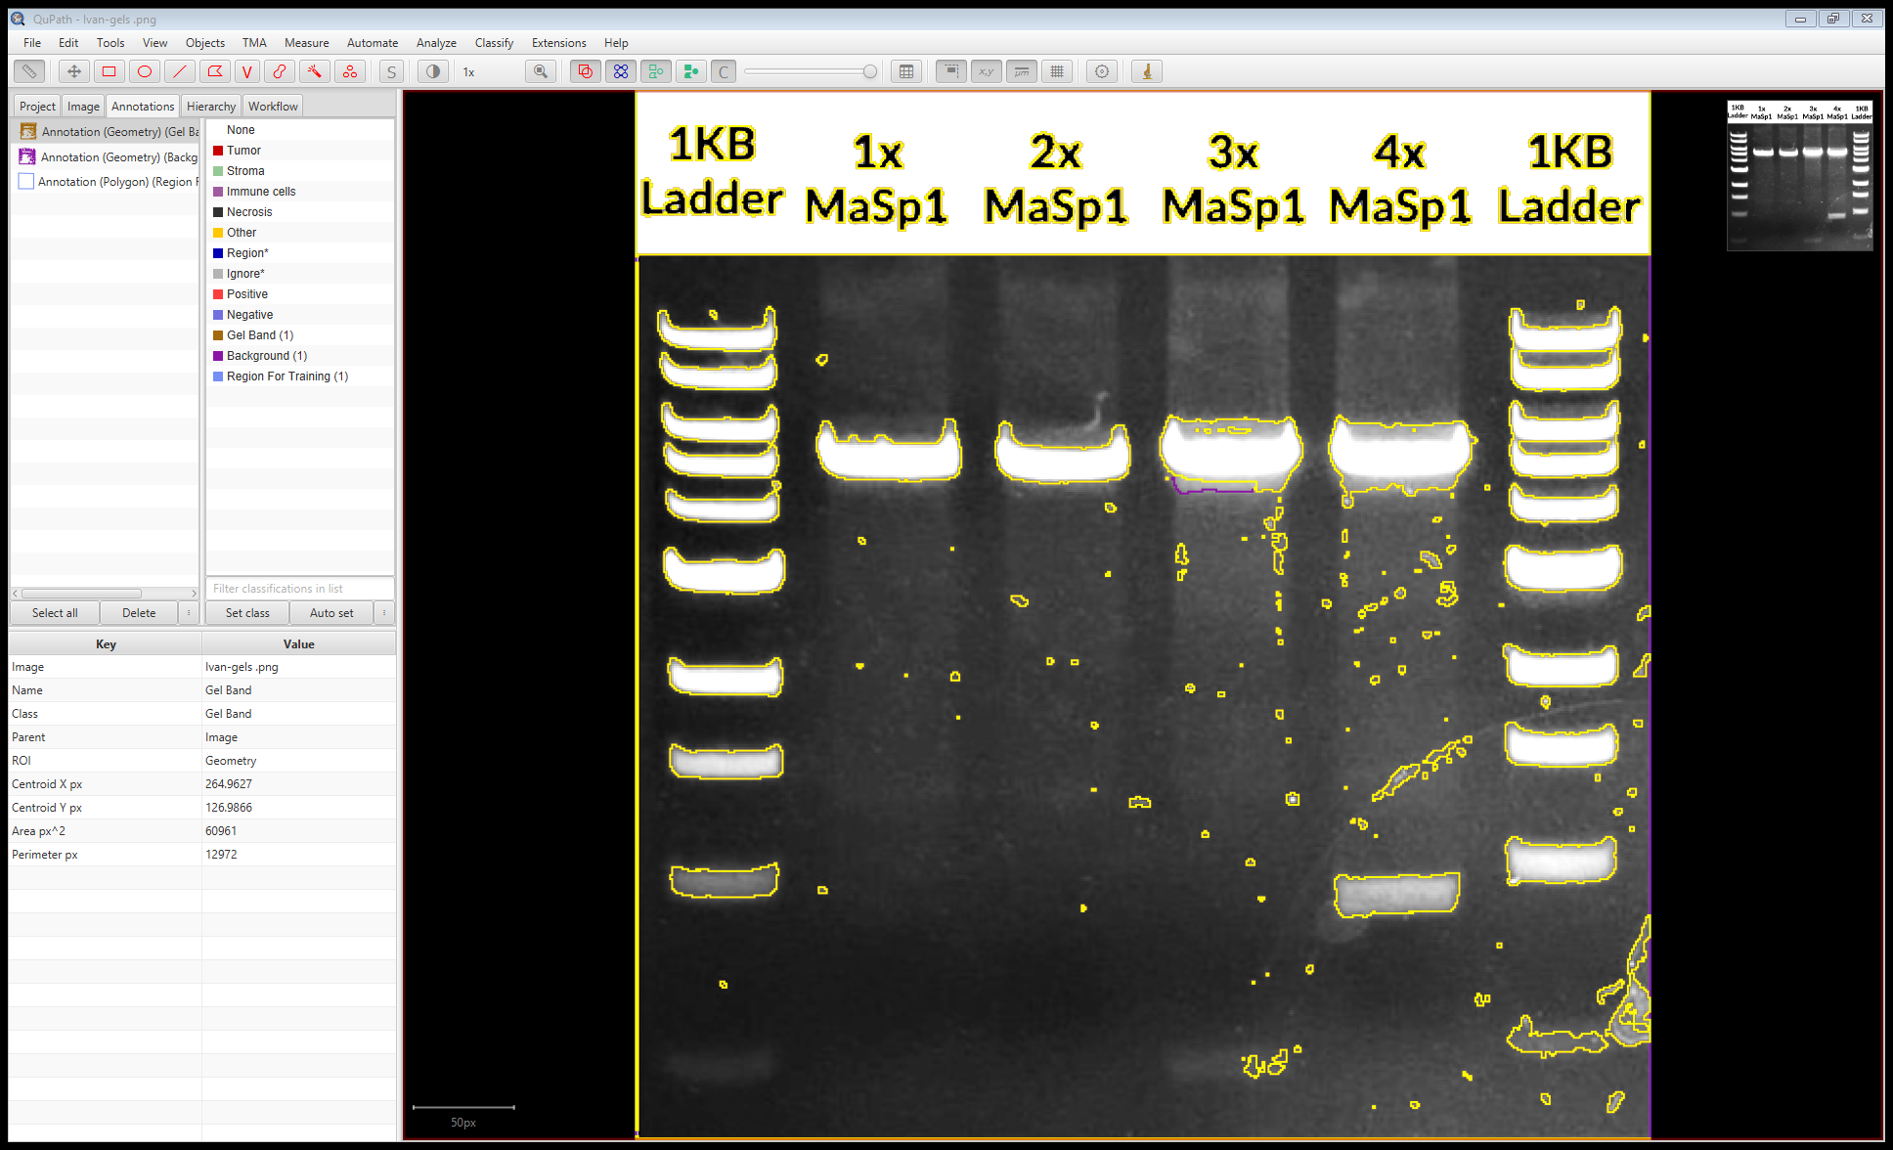
gel band area segmented are show as an annotation, and can be modified using QuPath tools

Slide 16
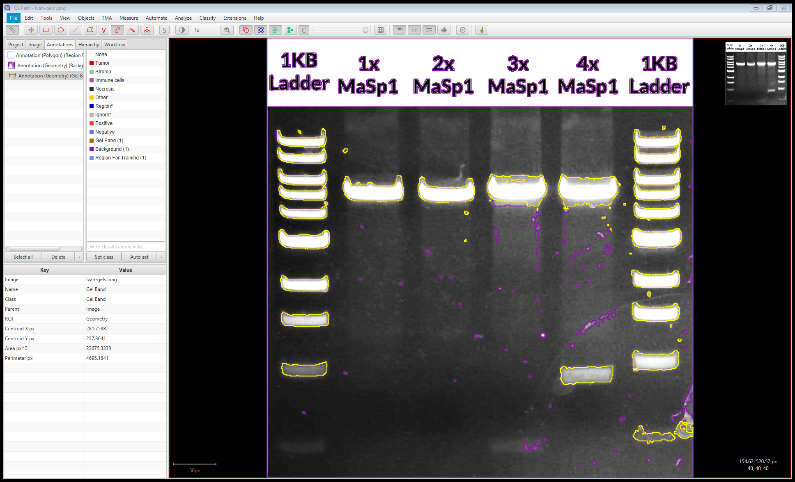
After some cleaning up (Just focus on yellow and ignore purple)

Slide 17
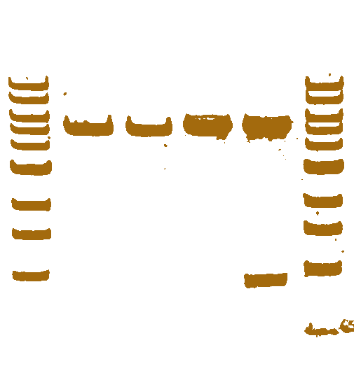
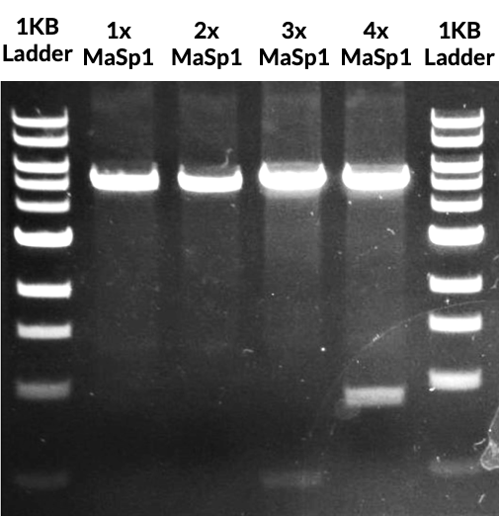
Comparing clean-ups

